Slide 1
CSCI 3511 Final Project – Arduino Music Box
Asia Keomanivong

Slide 2
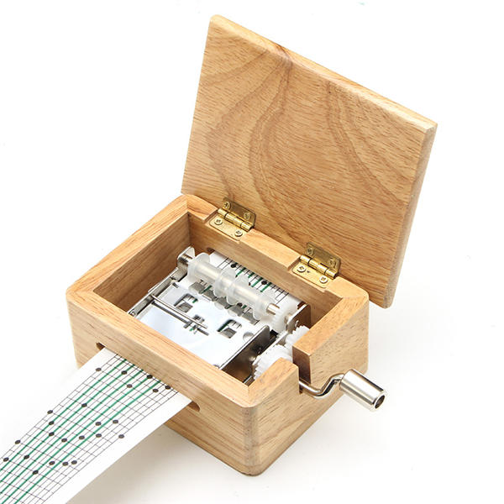
Music Box

Slide 3
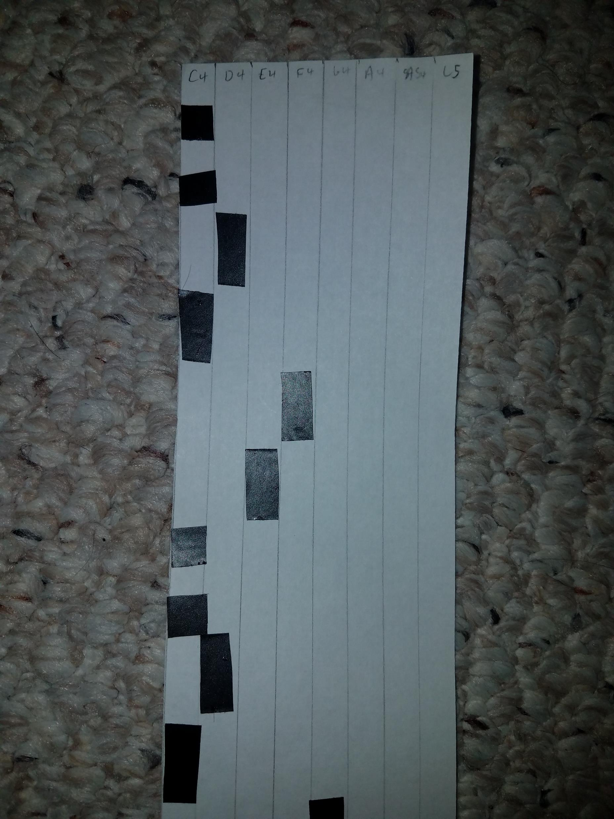
Functions
Music sheet (right) is fed through array of infrared LEDs and photodiodes
Eight columns that can be marked
Similar to a scantron
Marks on paper represent note to be played
Length of mark determines duration of note
Dark marks impede infrared light so when dark mark passes between an LED and photodiode, the photodiode will have a low reading, indicating that a note should be played
Each pair of LEDs and photodiodes correspond to the note marked on the sheet
Sound is played through the passive buzzer

Slide 4
Materials
Arduino Mega 2560
More analog pins
LM324 Op Amps
8 IR LEDs
8 IR photodiodes
10k potentiometer
Power supply module
Perf board
Passive buzzer
Jumper wires
Dupont wires
10k and 220 ohm resistors
Solder iron
A lot of time and patience

Slide 5
Testing
First tested the IR LEDs and photodiodes
Learned how to read photodiodes
Find out how to impede IR light
Used black electrical tape
Used op amps to get better readings from photodiodes
Used power supply module to get more power
Soldered components together after array was set
Used multimeter to ensure good wiring and proper setup
Wired everything together
Based off prototyping from IR LED and photodiode array
Connected passive buzzer with pitches.h to play different tones
System is fully functional

Slide 6
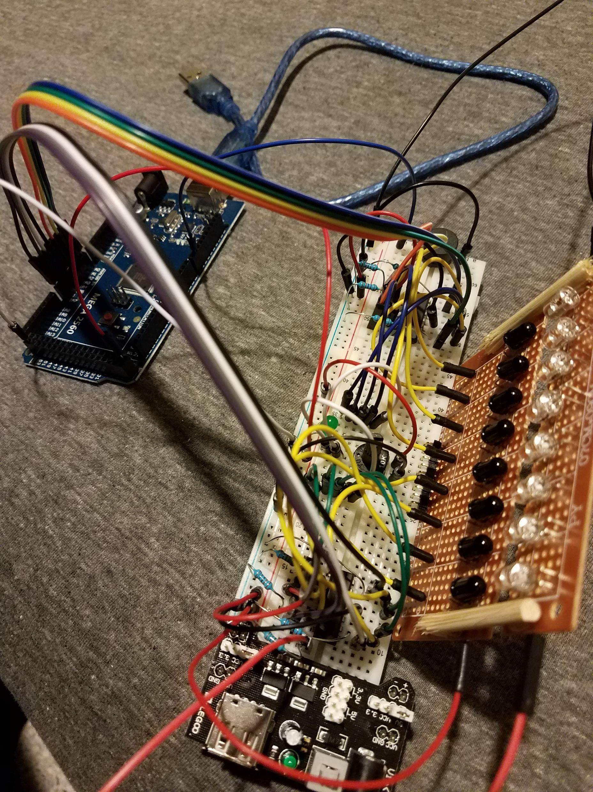
Challenges
Soldering for the first time
IR photodiodes
Bad readings
Op amps
Power
Wiring

Slide 7
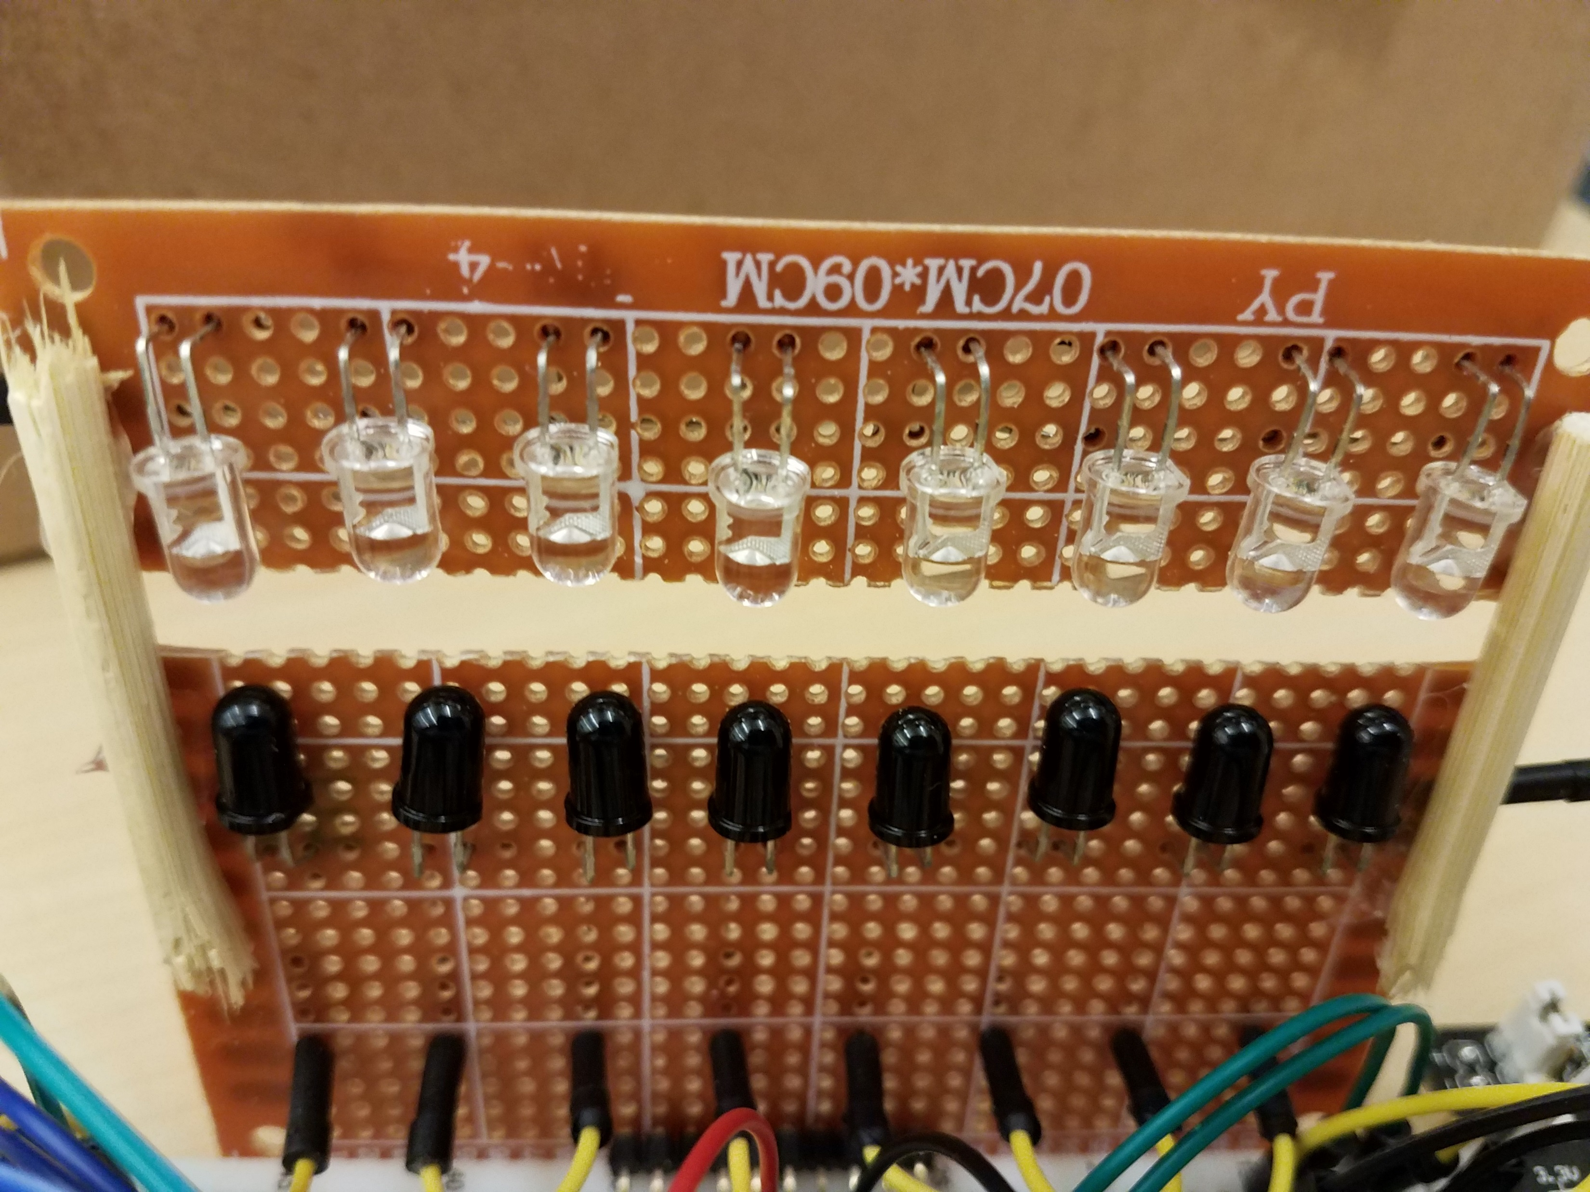
Functionality
Array of IR LEDs and photodiodes
IR light passes through paper
If there is a dark mark, IR light does not pass
Note will play
Note determined by which photodiode detects mark
Manual feeding

Slide 8
Demo

Slide 9
Final Thoughts
Enjoyable learning experience
Learned how to solder
IR and op amps
A lot of room for improvements and polish
Tidy up wiring
More LEDs and photodiodes for wider range of notes
Create housing
Better perf board construction
Rollers
Cleaner design overall

Slide 10
Questions?

